Slide 1

Week 3
RMDS Data Science Volunteer Team

Slide 2
Agenda
Feature Selection:
Feature selection and finding additional features to include
Evaluation Metrics (Climatology and Conventional Classification)
Machine Learning Improvements
Economic Loss as a Target Variable
Next Steps

Slide 3
Original Feature Set
‘PER’: TC intensity change in previous 12-h, unit in knot
‘SHRD’: 850-200 hPa vertical shear within a 500-km radius after vortex removal
‘D200’: 200 hPa divergence within a 1000-km radius
‘TPW’: Total precipitable water less than 45 mm, r=0 to 500 km in 90 deg azimuthal quadrant centered on up-shear direction
‘PC2’: Second principal component of GOES-IR imagery within a 440-km radius
‘SDBT’: Standard deviation of GOES-IR brightness temperature within 200 km radius
‘POT’: Potential intensity (current intensity – max potential intensity)
‘OHC’: Oceanic heat content
‘VMX0’: Max sustained wind at t=0h, unit in knot

Slide 4
Finding the Most Relevant Feature set
Through our feature selection methods, out of the 9 original these 4 were marked as most important:
POT: Potential intensity (current intensity – max potential intensity)
PER: TC intensity change in previous 12-h, unit in knot
SHRD: 850-200 hPa vertical shear within a 500-km radius after vortex removal
OHC: Oceanic heat content

Slide 5
Additional Features to be considered
U200: 200 hPa zonal wind
City and Country (via LAT and LON coordinates)
We could use the LAT and LON coordinates in the dataset to geocode the location. Perhaps high hurricane intensity is prone in certain regions.

Slide 6
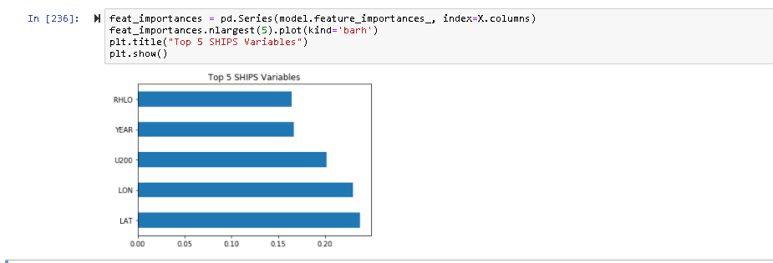
Top 5 variables:
LAT
POT
PER
YEAR
MSLP

Slide 7
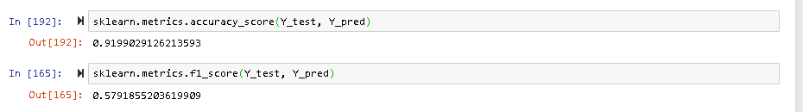

Slide 8
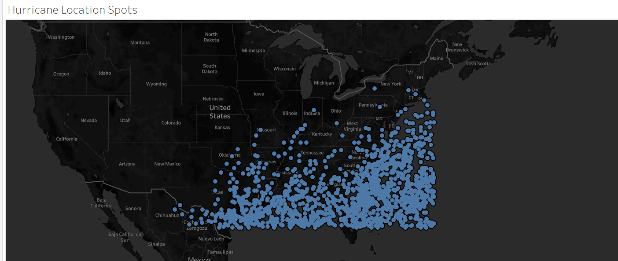

Slide 9
Possible Features to Add
Predicting Ecoomic Loss
GDP - Federal Reserve uses real GDP and other related economic indicators to adjust monetary policy.
Money Supply - Economists and others also use M2 data to predict cyclical economic recessions and recoveries and expected changes in stock prices and also expected changes in the Fed's monetary policy.
Consumer Price Index - This statistic is the best indicator of inflation that we must rely on. Changes in inflation can spur the Fed to take action to change its monetary policy.
Current Employee Statistics - This is the earliest indicator of economic trends released each month.
S&P 500 - The index is designed to measure changes in the stock prices of component companies. It is used as a measure of the nation's stock of capital, as well as a gauge of future business and consumer confidence levels. Growth of the S&P 500 index can translate into growth of business investment. It can also be a clue to higher future consumer spending. A declining S&P 500 index can signal a tightening of belts for both businesses and consumers.
Population – High economic loss could be associated with high population density?
Predicting Hurricane Intensity Forecast
City and Country – We could use the LAT and LON coordinates in the dataset to geocode the location. Perhaps high hurricane intensity is prone in certain regions
Rainfall of the region- High hurricane Intensity could be associated with heavy rainfall in the region

Slide 10
Features for Economic Loss
GDP
Federal Reserve uses real GDP and other related economic indicators to adjust monetary policy.
Money Supply
Economists and others also use M2 data to predict cyclical economic recessions and recoveries, expected changes in stock prices, and expected changes in the Fed's monetary policy.
Consumer Price Index (CPI)
This statistic is the best indicator of inflation. Changes in inflation can spur the Fed to take action to change its monetary policy.
Current Employment Statistics (CES)
This is the earliest indicator of economic trends released each month.
S&P 500
The index is designed to measure changes in the stock prices of component companies. It is used as a measure of the nation's stock of capital, as well as a gauge of future business and consumer confidence levels. Growth of the S&P 500 index can translate into growth of business investment.

Slide 11
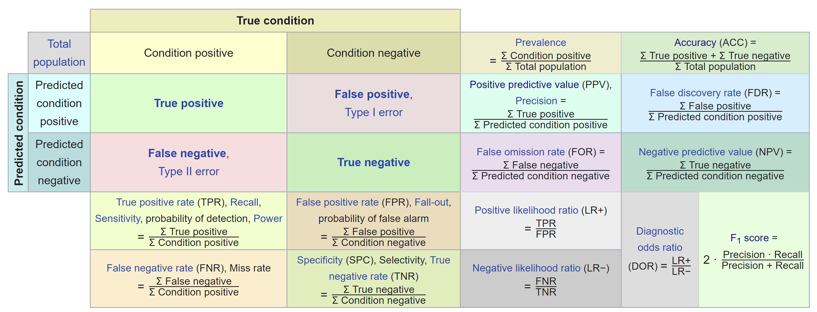
Evaluation Metrics
Accuracy
Confusion Matrix (False Positive, False Negative)
Pierce Skill Score (PSS)
Probability of Detection (POD)
False Alarm Ratio (FAR)
Brier Score
accuracy of probabilistic predictions
F1
Precision

Slide 12
Machine Learning Improvements (Kooha)
Data Addition*
Sampling Methods
Under-Sampling
Over-Sampling
Normalization
K-Fold Validation*
Leave-one-out cross validation*
Feature Selections
Model Variations
Log Regression
K-Neighbor Classifier
Decision Tree
Random Forest
Neural Networks
$$Number of Outputs= Sampling Methods ×Feature Selections ×Model Types$$
*not Implemented to the current version

Slide 13
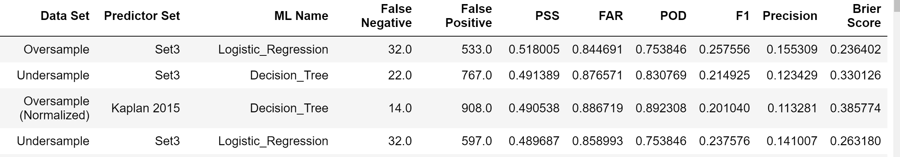
RI Prediction Model Summary (Kooha)
Purpose:
To build most effective model to predict RI classification (RI or non-RI) of hurricanes using SHIPs data
Methodology:
Multiple models was created using different sampling methods, predictor sets, and machine learning types
Each model was evaluated using evaluation metrics such as: PSS, FAR, POD, F1, etc.
Conclusion:
Models with the highest Pierce Score (PSS) had characteristics of:
Over/Undersamping
Data Set 3
Logistic Regression or Decision Tree Modeling

Slide 14
Machine Learning Improvements (Wanying)
Model | parameters | variables | compares to Raksha's model | PSS, FAR and POD
Raksha's model |  |  | (fig.1) | PSS=0.3298 FAR=0.8056 POD=0.5469
Random Forest | not tune | delete ‘VMX0’ | improve slightly (fig.2) | PSS=0.3399 FAR=0.8017 POD=0.5547
Random Forest | not tune | add several variables | not improve (fig.3) | PSS=0.3035 FAR=0.8077 POD=0.5078
Random Forest | have tuned | not add | improve slightly with training dataset, but perform worse with testing dataset
Gradient Boosting Classify (It is a good model, but it is difficult to tune the parameters.) | have tuned | not add | FAR improves, PSS and POD decrease. (fig.4) | PSS=0.1031 FAR=0.7802 POD=0.1563
Logistic regression | class_weight='balanced' other: default value | with ‘VMX0’ | PSS and POD improve slightly, while FAR performs worse (fig. 5) | PSS=0.3432 FAR=0.8225 POD=0.6172
Logistic regression | class_weight='balanced' other: default value | delete ‘VMX0’ due to multicollinearity | Compares to Logistics Reg with ‘VMX0’, PSS and POD improve slightly, while FAR performs worse (fig. 6) | PSS=0.3624 FAR=0.8258 POD=0.6641

Slide 15
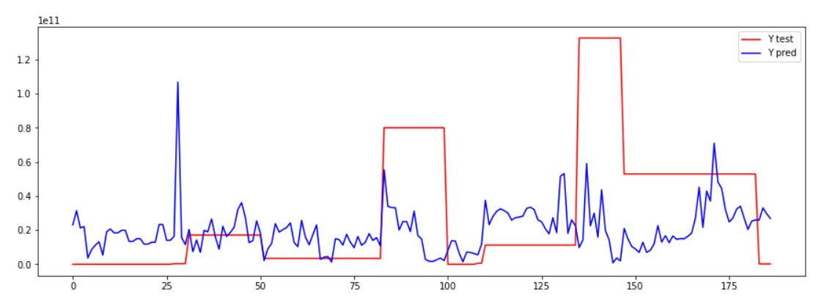
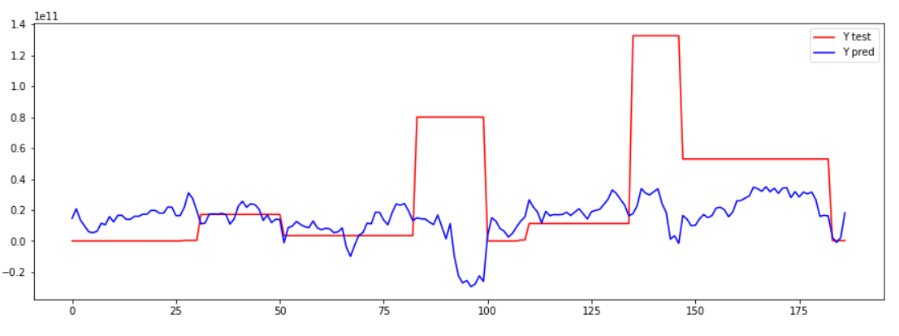
Prediction ML Model (Economic Loss)
Data Set
icatdamageestimator.com/viewdata
N = 59 (one for each storm)
Predictand = Current Damage ($) (2020)
Random Forest Regressor:
Linear Regression:

Slide 16
Next Steps
Implementing Newly Found Features (Neel and Akshay) into the script
Combine two ML scripts together
Hyperparameter tuning and implementing different sampling methods for RI Prediction Model
Further build on Economic Loss Model
Any others?

